Slide 1
Vrinda Retail Store Data
-Sonali Pawar

Slide 2
Introduction
The project undertakes a comprehensive data analysis of a sample super store to understand its operational intricacies. By examining key metrics and trends, the study aims to derive actionable insights for business optimization. Using a blend of statistical tools and data visualization techniques, we will evaluate the store's sales, profitability, and customer behaviour patterns. The findings from this analysis can offer valuable perspectives for stakeholders, aiding in informed decision-making and strategy formulation for the store's future.

Slide 3
Information of Dataset
Index – Serial number or row index of the dataset
Order ID - A unique identifier for each order.
Cust ID - Unique customer ID
Age group – categorized age bracket: Teenager, Adult, or senior.
Staus – final status of the order: delivered, cancelled, refunded.
Category- type of product sold
Ship-city- state where the order was shipped

Slide 4
Data Preparation
DATA PREPARATION:
We have 3 tables viz Product, customer & orders. All connected using statistical function.
DATA CLEANING
Converted all columns with there matching datatype Ex.(vehicle_type is converted into text format….)

Slide 5
Quick INSIGHTS (Using conditional Formatting, Filter , Custom Filters, Sorts.)
Total Revenue :2.1+ crores
Highest sales month: March
Lowest sales month: January
Total orders processed: 30,000+
Delivered orders: 28641
Cancelled orders: 844
Refunded ordered: 517
Women customers contributed 64% of total revenue
Men customers contributed 36%
Top Performing Platforms:
Amazon: 35.48% of total orders
Flipkart: 21.59%
Aijo: 6.21%

Slide 6
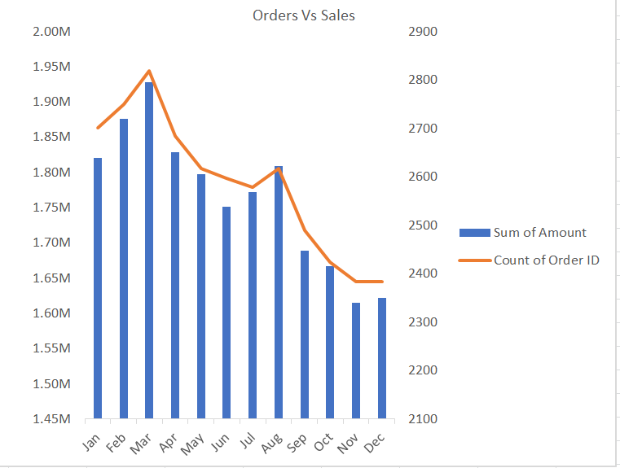
Detailed insights
The chart compares monthly sales and order volumes for vrinda store in2022. march recorded the highest sales and orders ,indicating peak business performance . sales and orders remained fairly stable from january to july , followed by a noticeable drop in august and october, possibly due to seasonality or reduced demand.

Slide 7
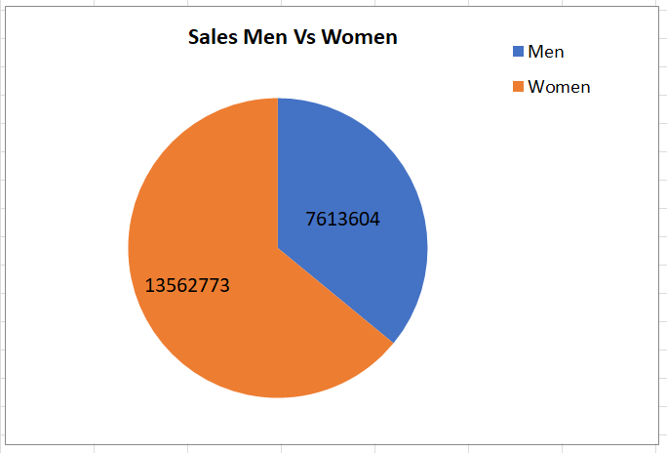
Women customers contributed 13.56 lakh in sales
Men customers contributed 7.61 lakh in sales
Sales from women are double compared to men, indicating a stronger purchasing behavior or focus on women-orient products.

Slide 8
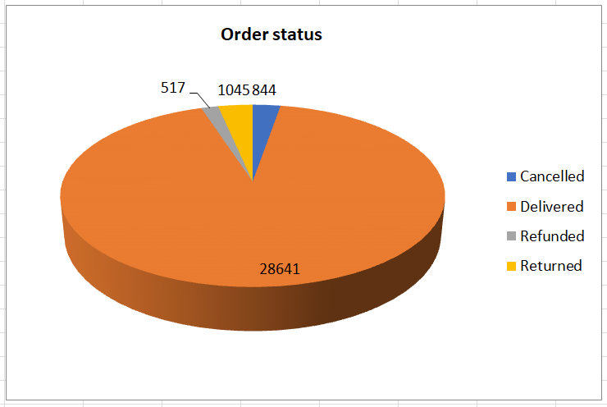
A large majority of orders (over 90%) were successfully delivered.
Only a small portion of orders were cancelled, refunded, or returned, indicating efficient order fulfillment and high customer satisfaction.

Slide 9
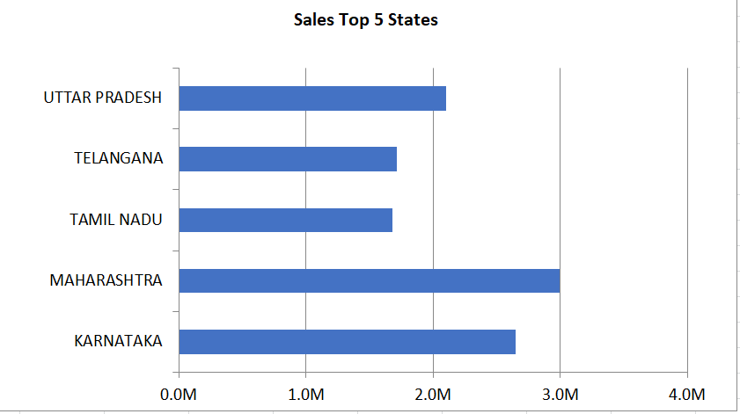
Karnataka is the top-performing state, contributing the highest revenue.
Followed by Maharastra and TamilNadu
These top 5 states represent strong market regions for vrinda store, ideal for marketing focus or expansion.

Slide 10
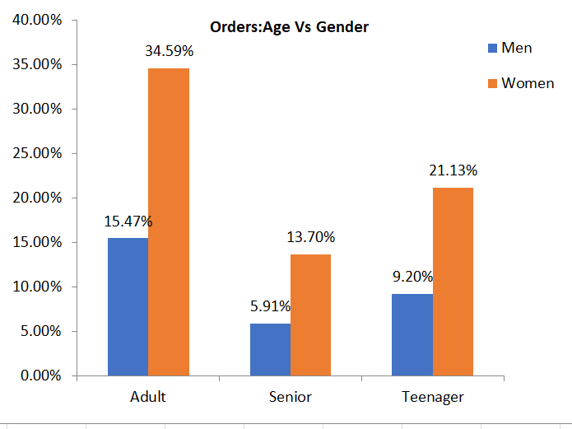
The chart and table show the percentage of orders placed by gender (men and women) across different age groups.-Teenager, senior, and adult.
Overall gender split:
Women: 69.42% of total orders
Men: 30.58% of total orders
Women contribute to more than twice the number of orders compared to men.

Slide 11
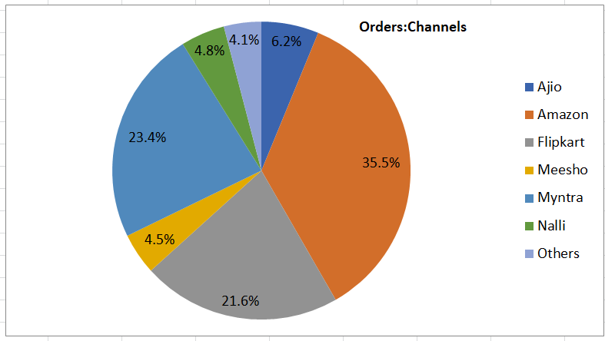
This visualization shows the percentage of orders received from different shopping platforms.
Amazon dominates with 35.5% of total orders, making is the most popular shopping channel.

Slide 12
Action steps:
Invest more in ads, deals, and product visibility on these platforms
Analyze why customers are not ordering as much on this platforms( e.g pricing, product range, visibility).
Improve product listings use seasonal promotions or test different pricing strategies
Run targeted ads on platforms aligned with the most active customer segments( e.g adult women on Amazon).

Slide 13
conclusion
Helps in identifying high-value customers segments.
Enables platform-wise strategy building
Supports targeted markerting campaigns to boost sales and engagement.

Slide 14
Thank you☺

